Slide 1
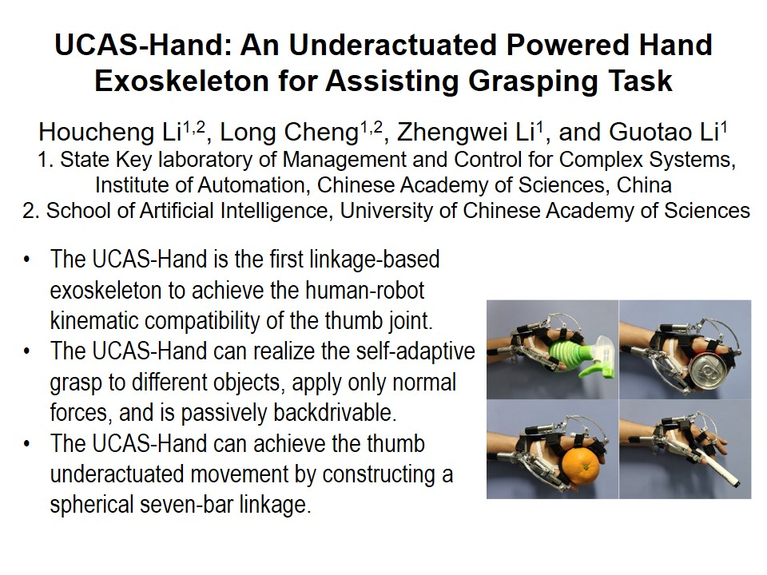
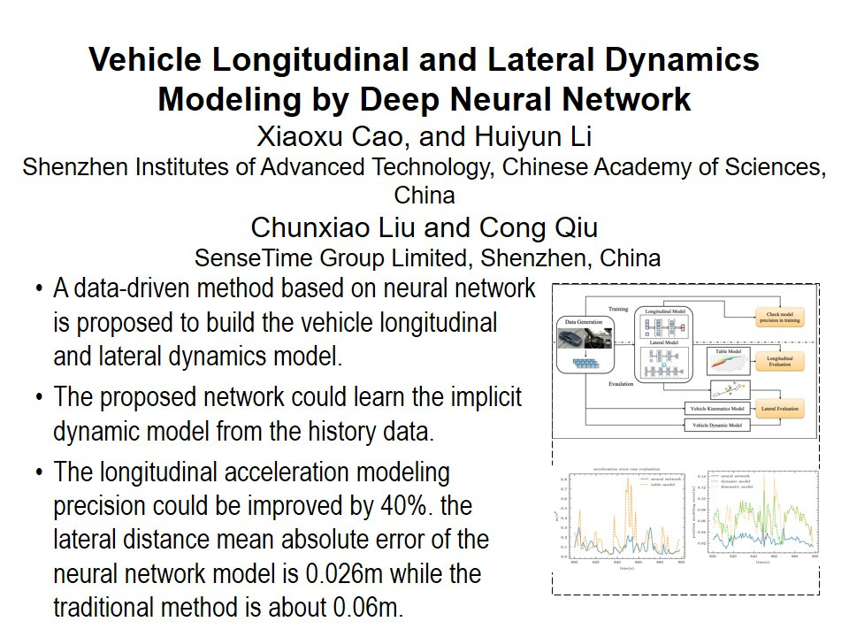
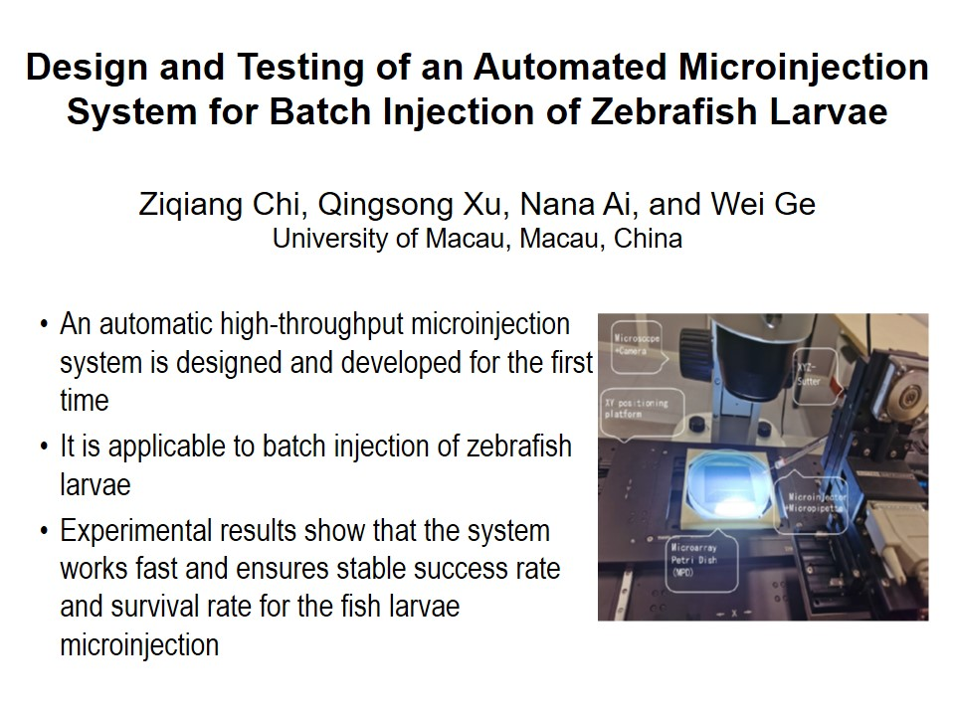
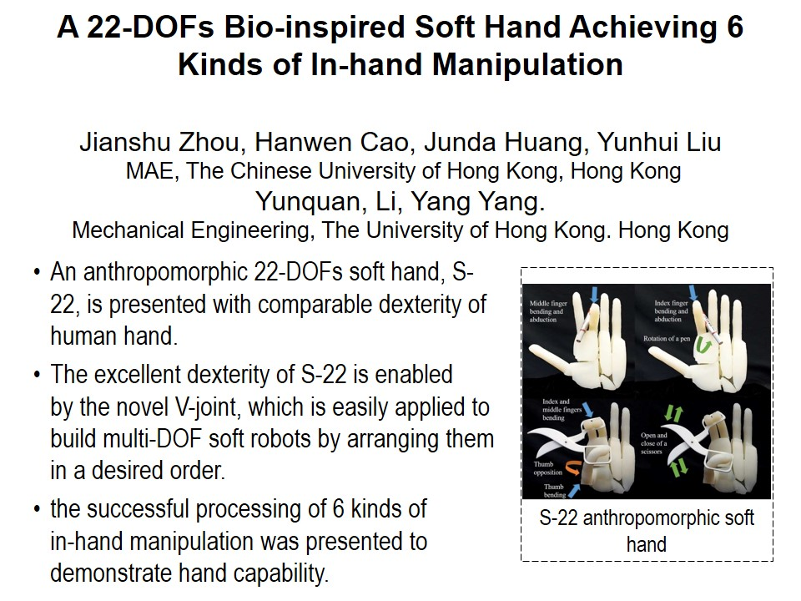
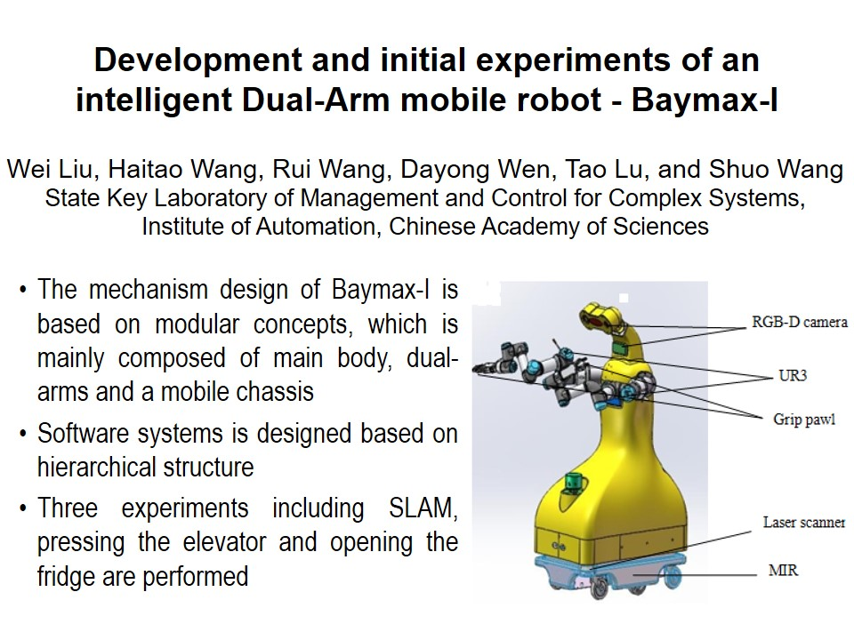
RCAR2021 Technical Sessions
ThA I : Best Paper
Session Chair : Hong Zhang
Jingya Pavilion : July 15, 14:00 - 15:45, Thursday
14:00~14:15
14:15~14:30
14:30~14:45
14:45~15:00
15:00~15:15
T-1

Slide 2
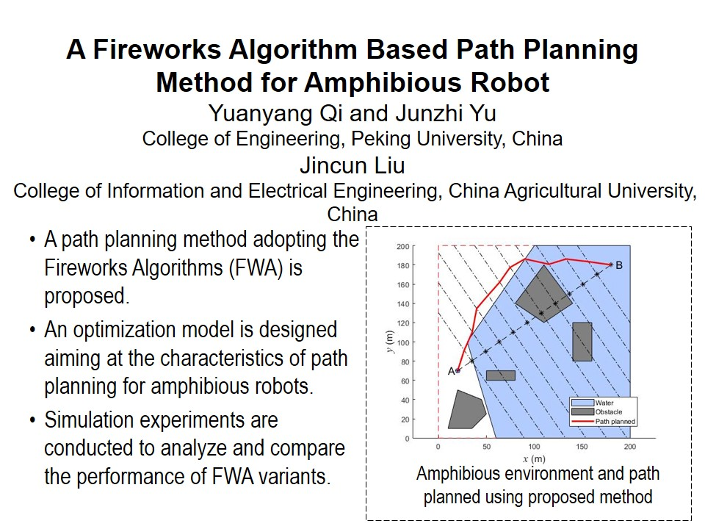

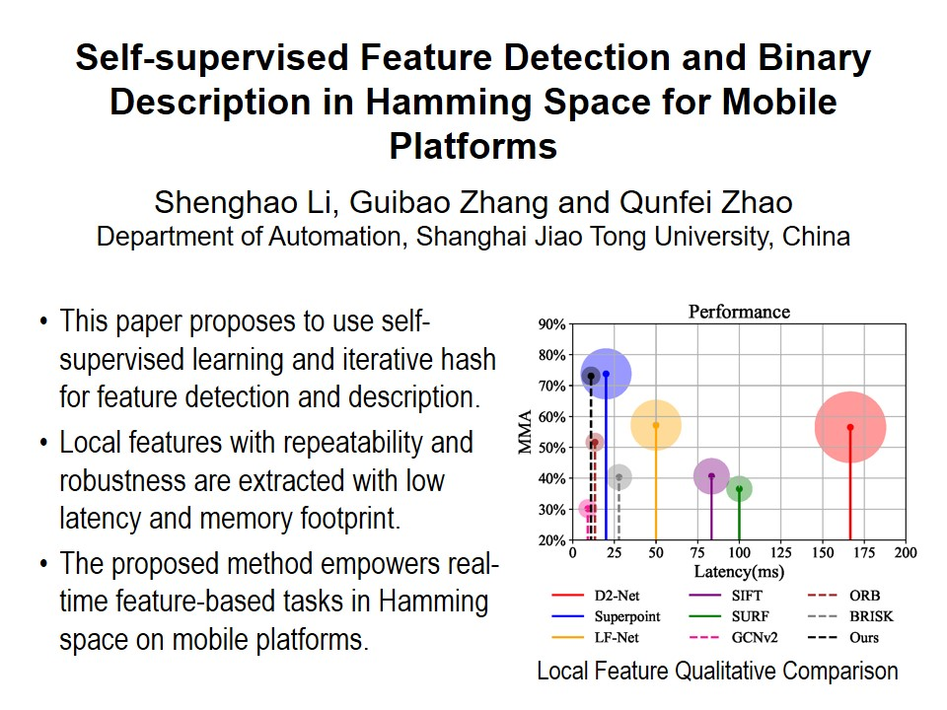
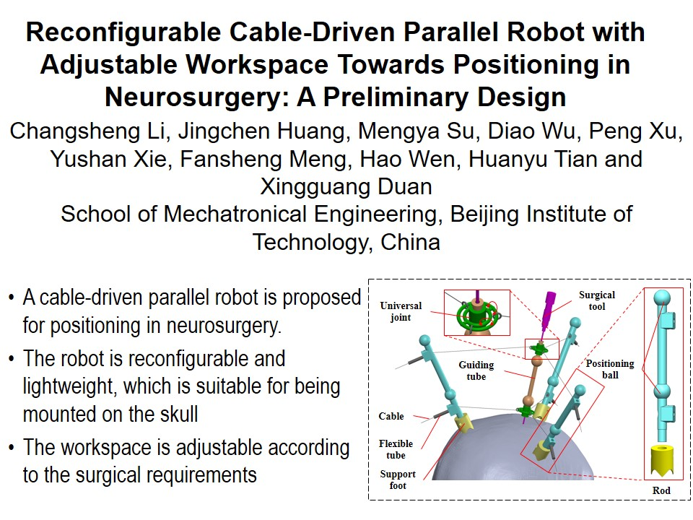
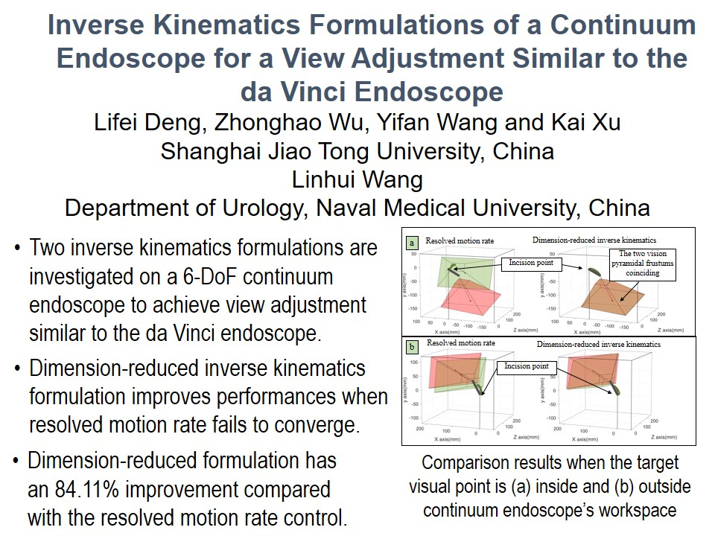
RCAR2021 Technical Sessions
ThB I : Best Paper In Robotics
Session Chair : Max Q.-H. Meng
Lanting Pavilion : July 15, 14:00 - 15:45, Thursday
14:00~14:15
14:15~14:30
14:30~14:45
14:45~15:00
15:00~15:15
T-2

Slide 3
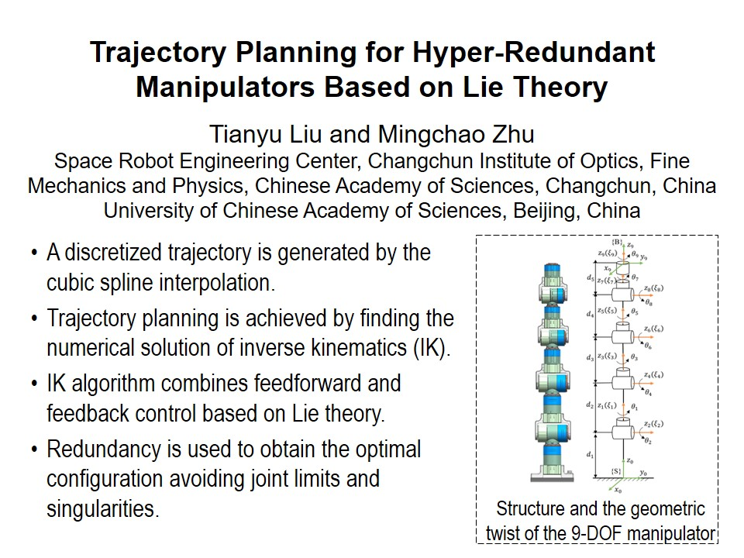
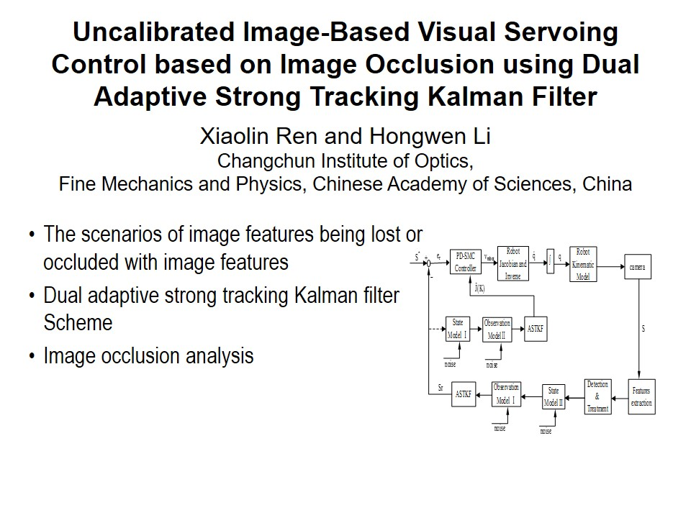
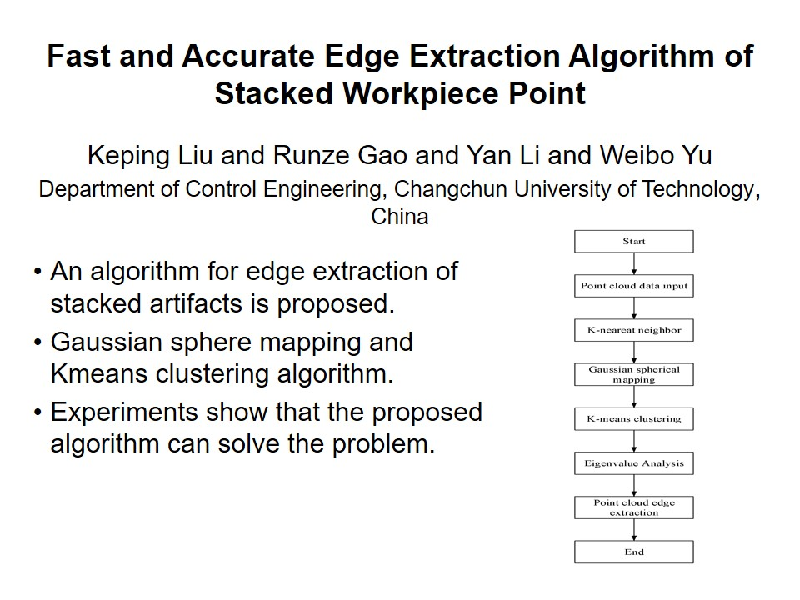
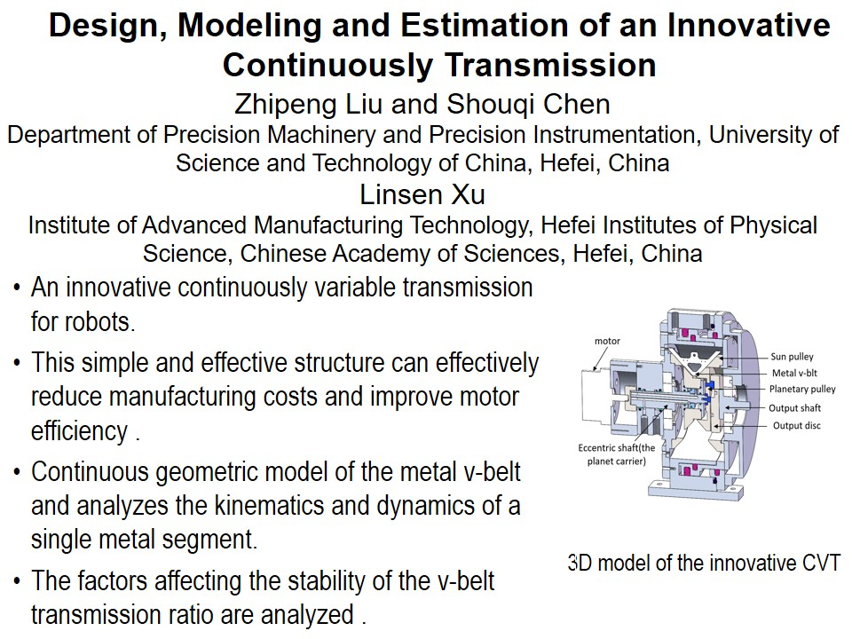
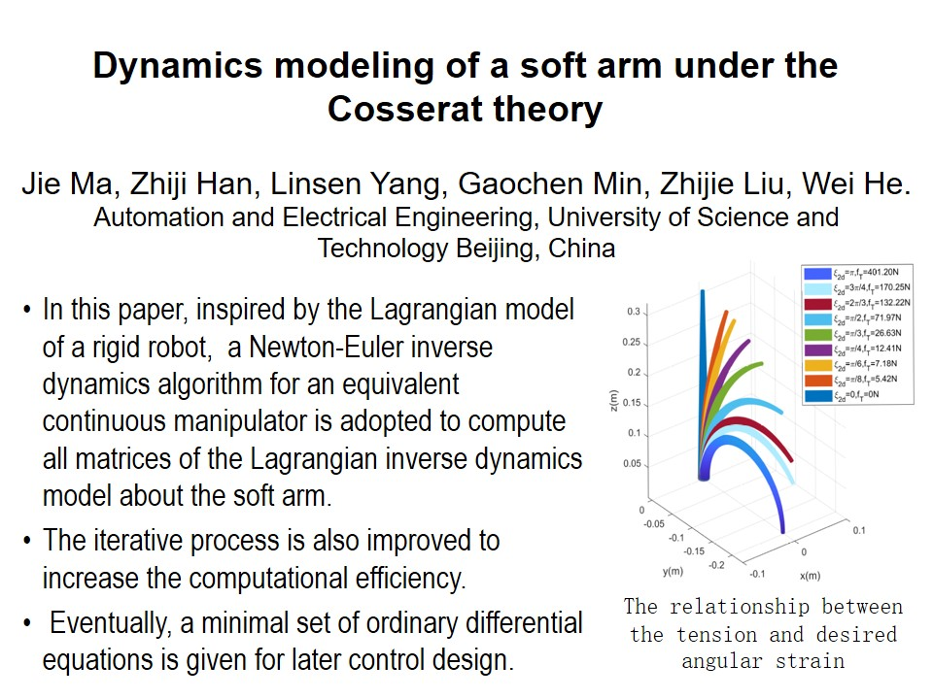
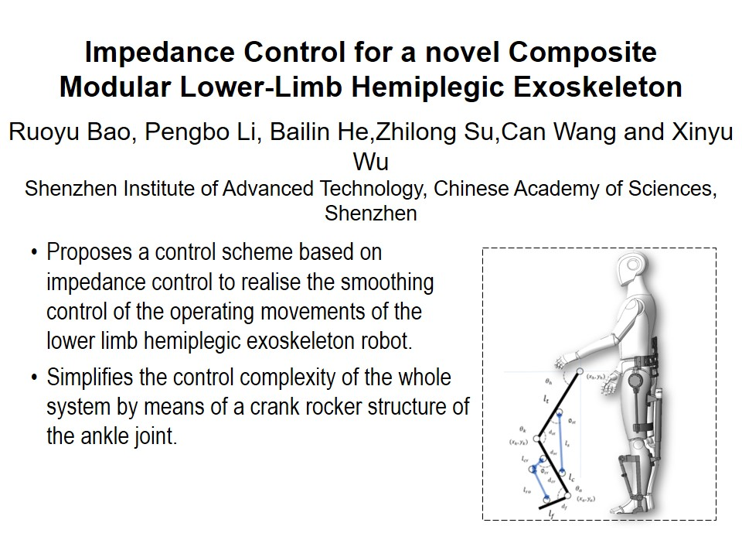
RCAR2021 Technical Sessions
ThC I : Robotics Control Ⅰ
Session Chair : Bo Zhao, Can Wang
Meeting Room 1 : July 15, 14:00 - 15:45, Thursday
14:00~14:15
14:15~14:30
14:30~14:45
14:45~15:00
15:00~15:15
15:15~15:30
T-3

Slide 4
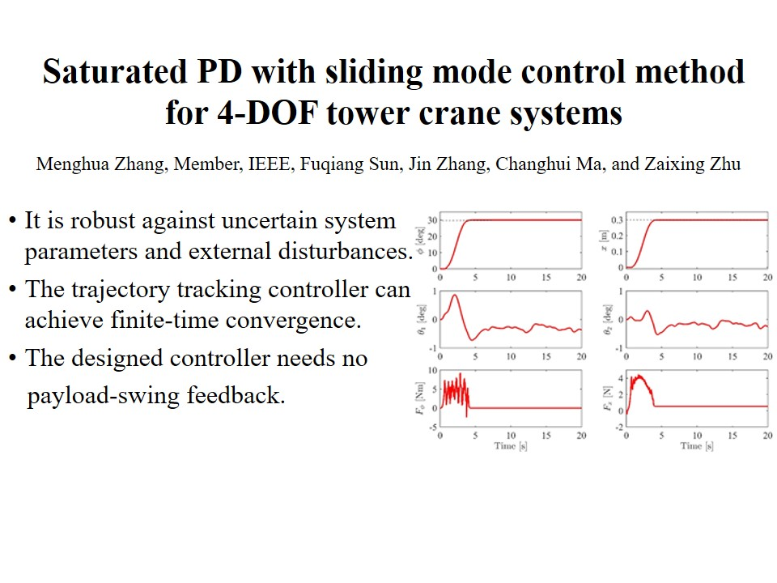
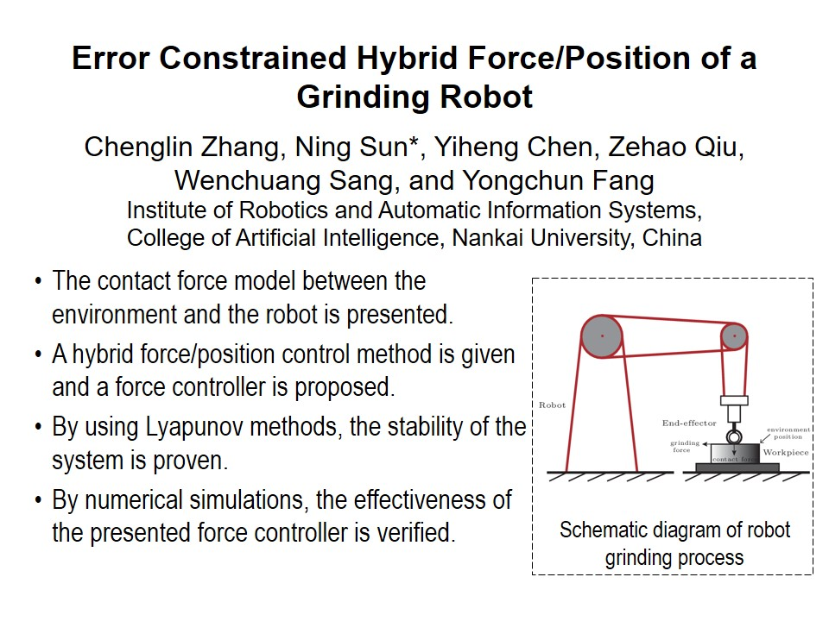
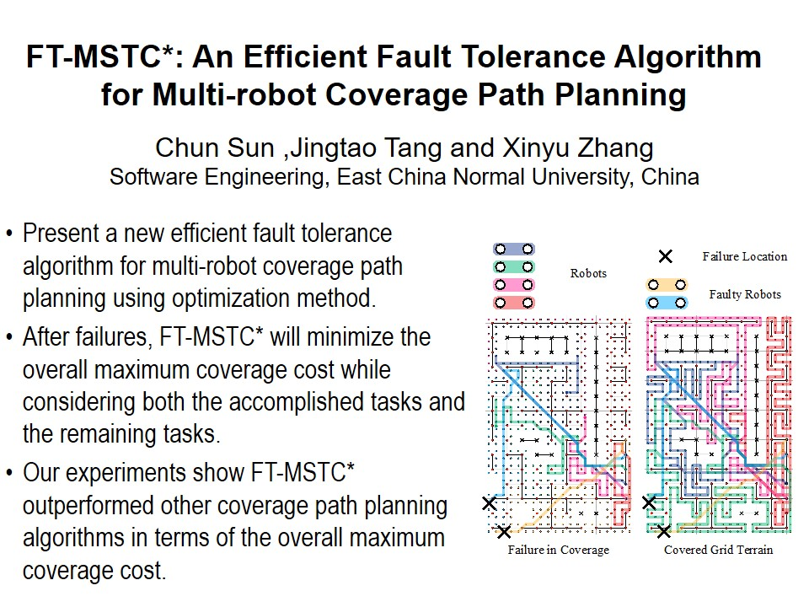
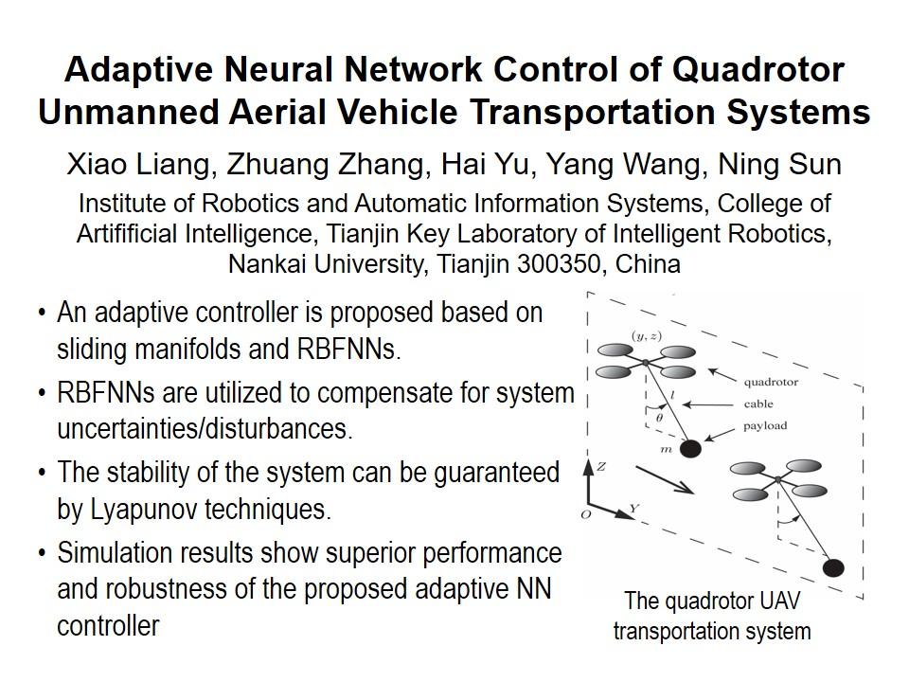
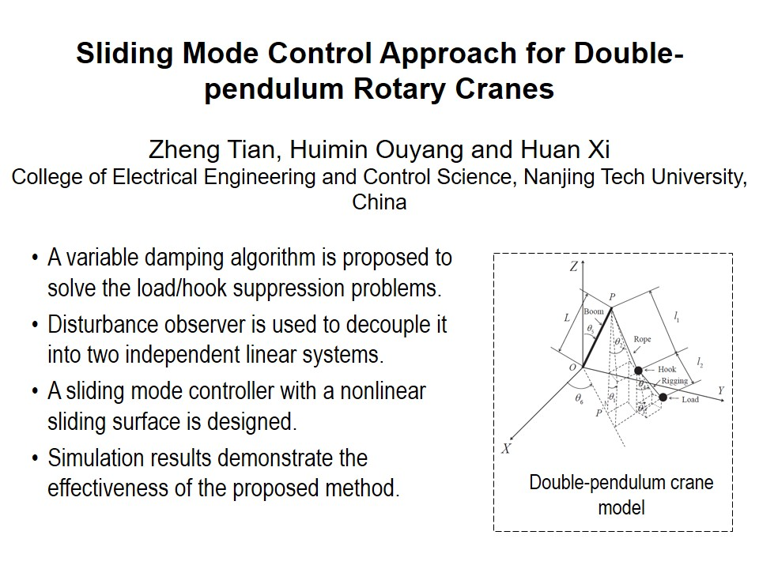
RCAR2021 Technical Sessions
ThD I : Soft robotic system I
Session Chair : Zhi Li, Wu Yinan
Meeting Room 2 : July 15, 14:00 - 15:45, Thursday
14:00~14:15
14:15~14:30
14:30~14:45
14:45~15:00
15:00~15:15
T-4

Slide 5
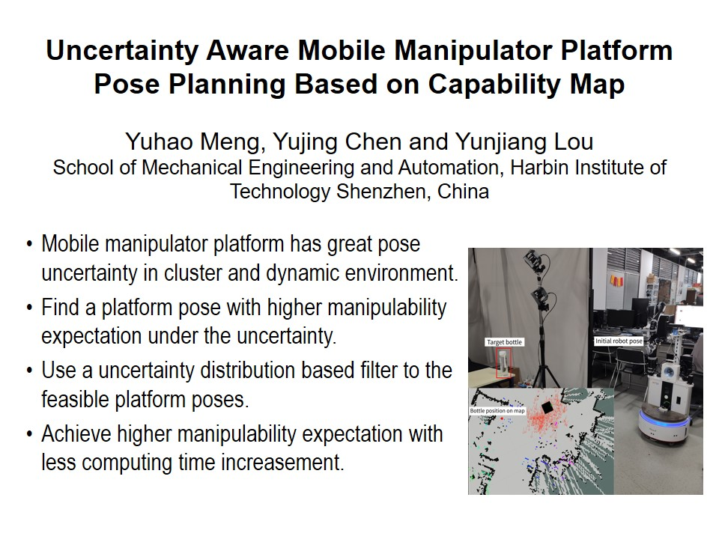
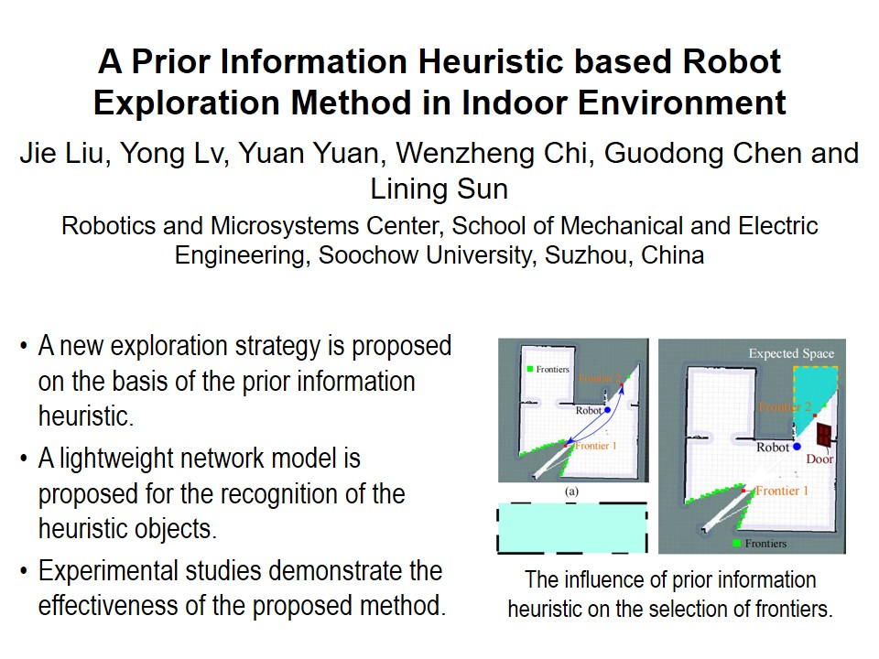
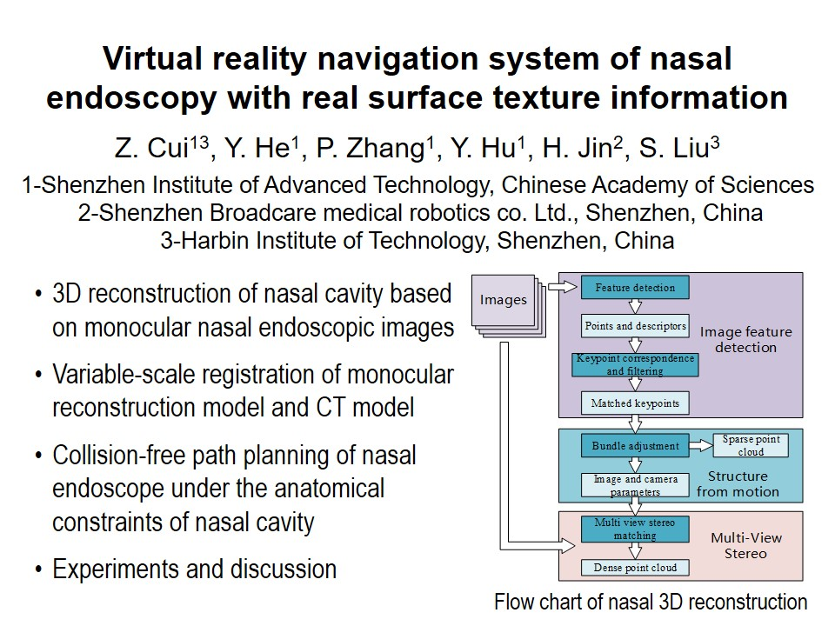
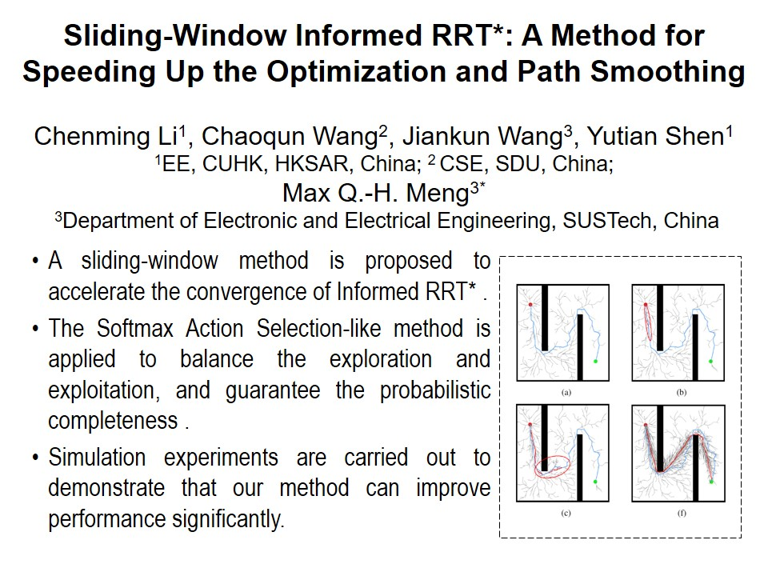
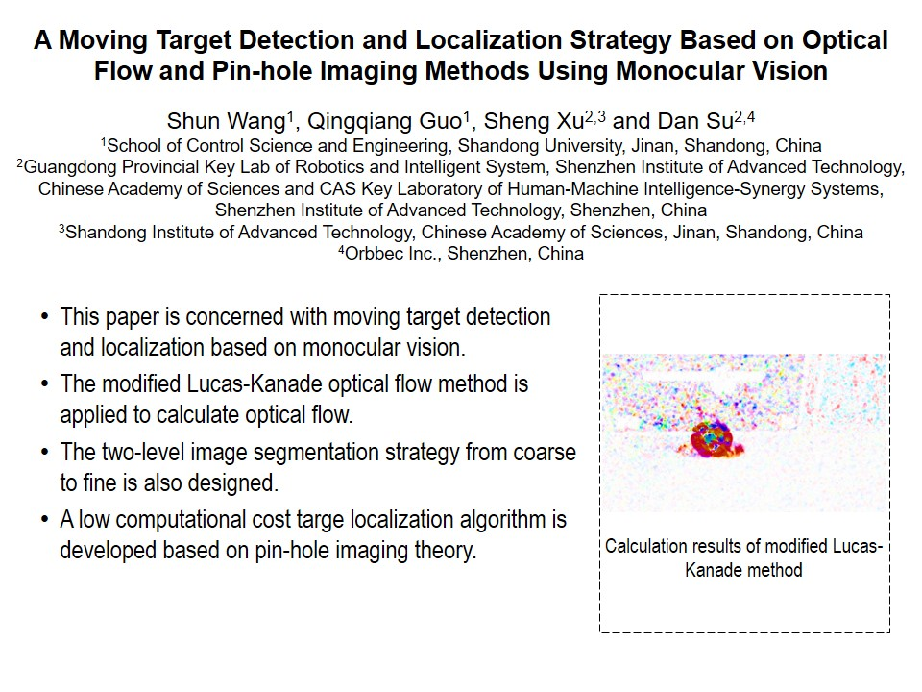
RCAR2021 Technical Sessions
ThA Ⅱ : Best Student Paper
Session Chair : Hong Zhang
Jingya Pavilion : July 15, 16:15 - 18:00, Thursday
16:15~16:30
16:30~16:45
16:45~17:00
17:00~17:15
17:15~17:30
T-5

Slide 6
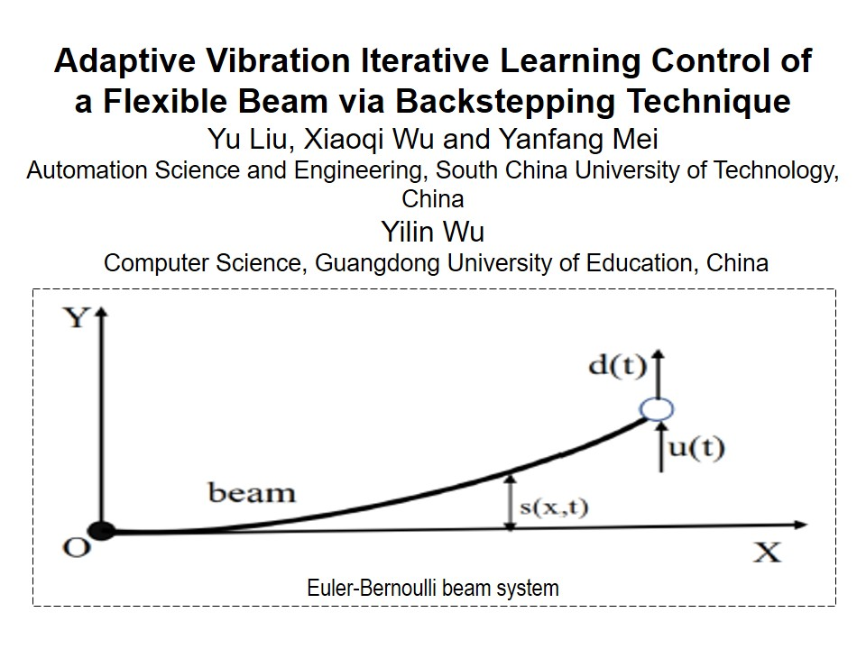
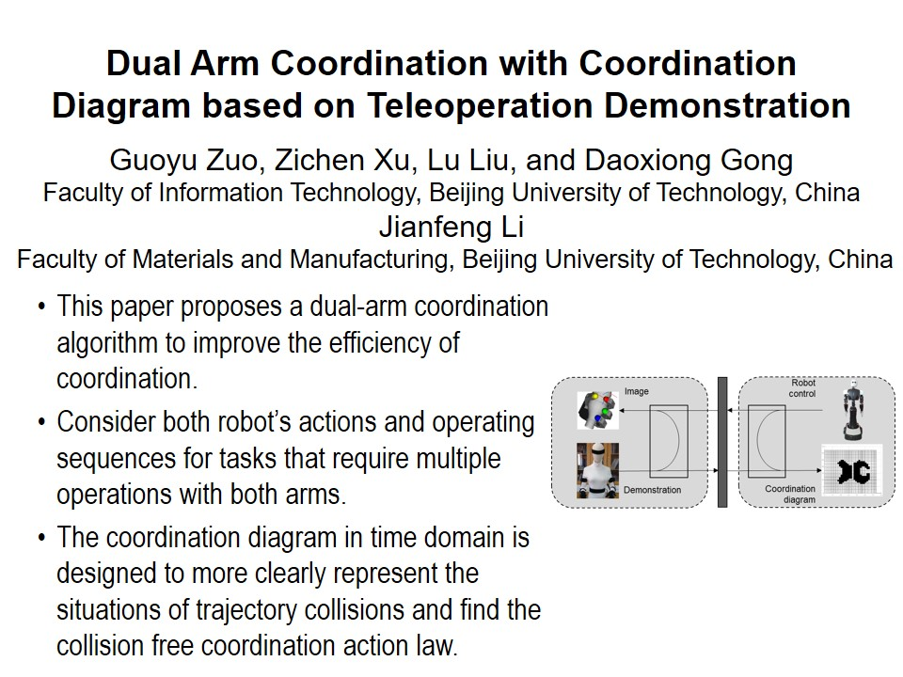
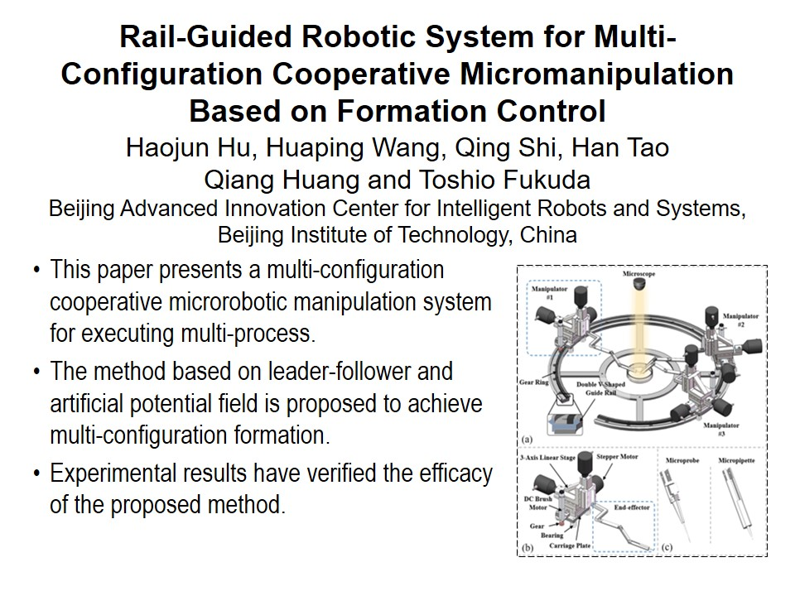
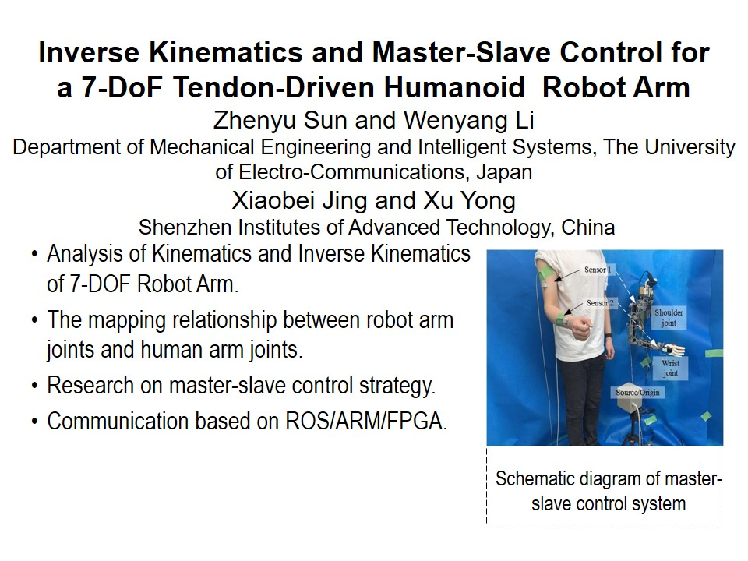
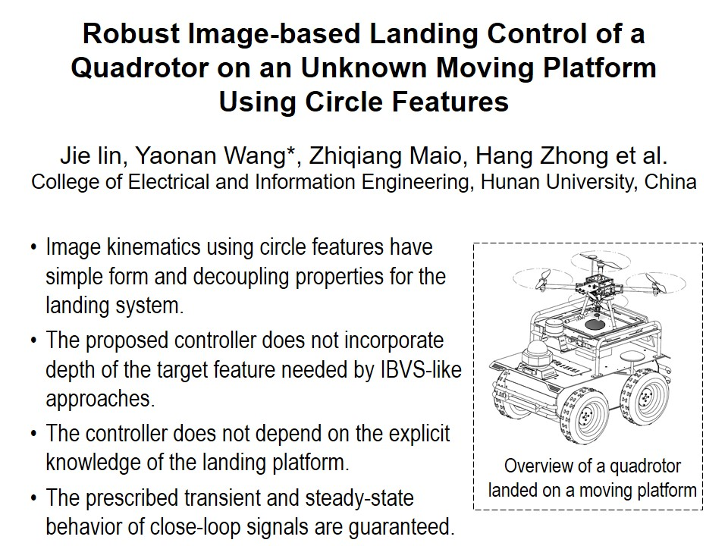
RCAR2021 Technical Sessions
ThB Ⅱ : Best Paper In Control
Session Chair : Max Q.-H. Meng
Lanting Pavilion : July 15, 16:15 - 18:00, Thursday
16:15~16:30
16:30~16:45
16:45~17:00
17:00~17:15
17:15~17:30
T-6

Slide 7
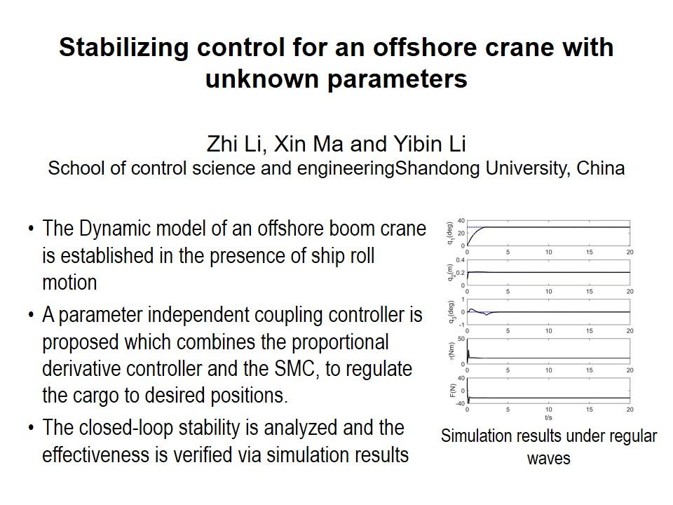
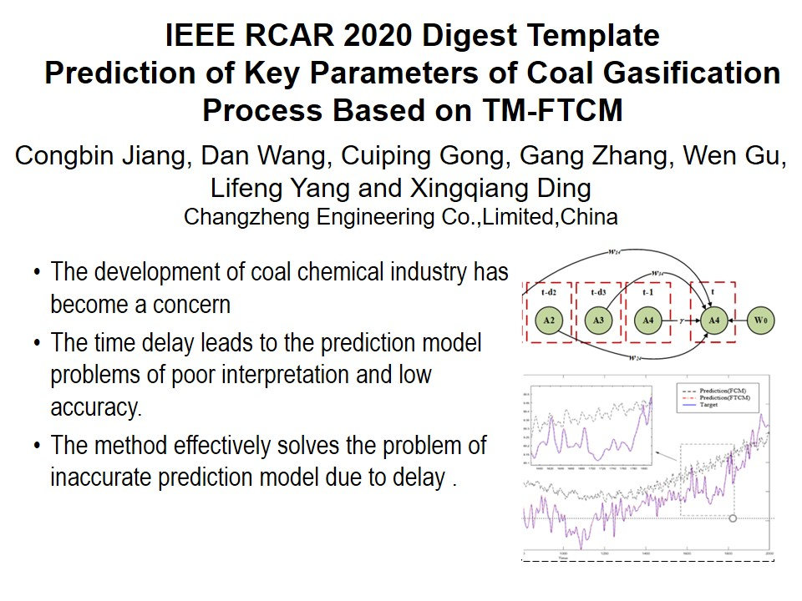
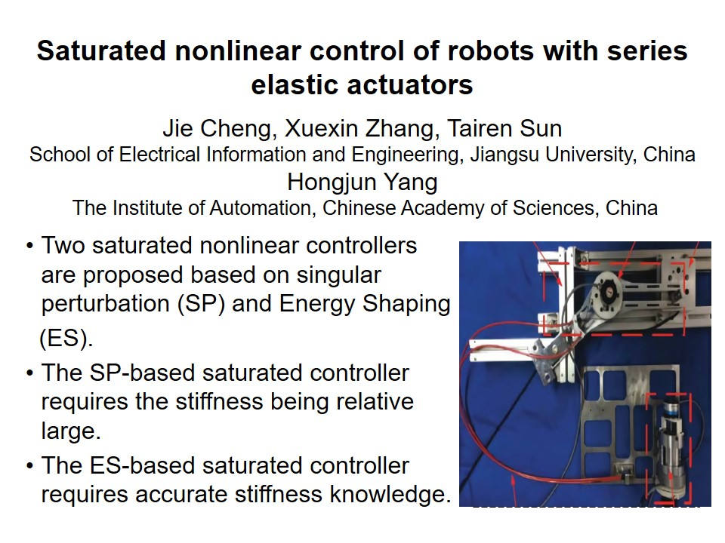

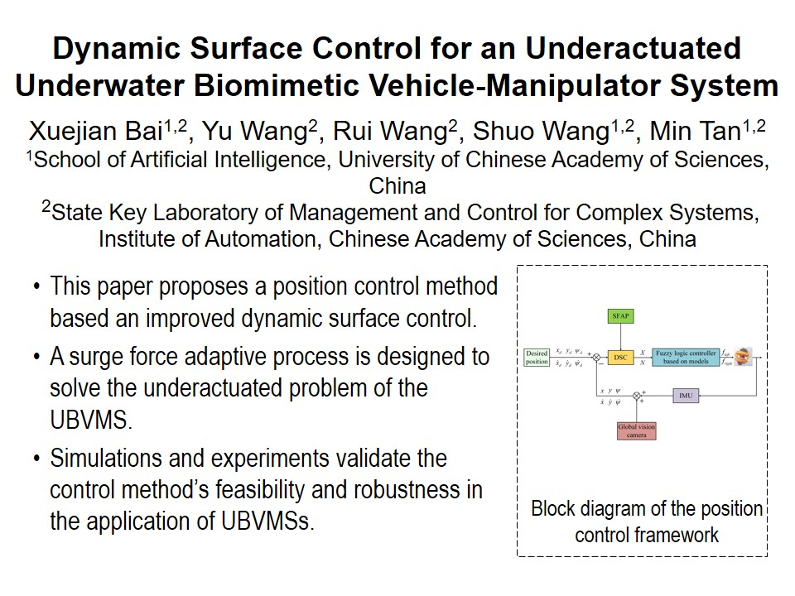
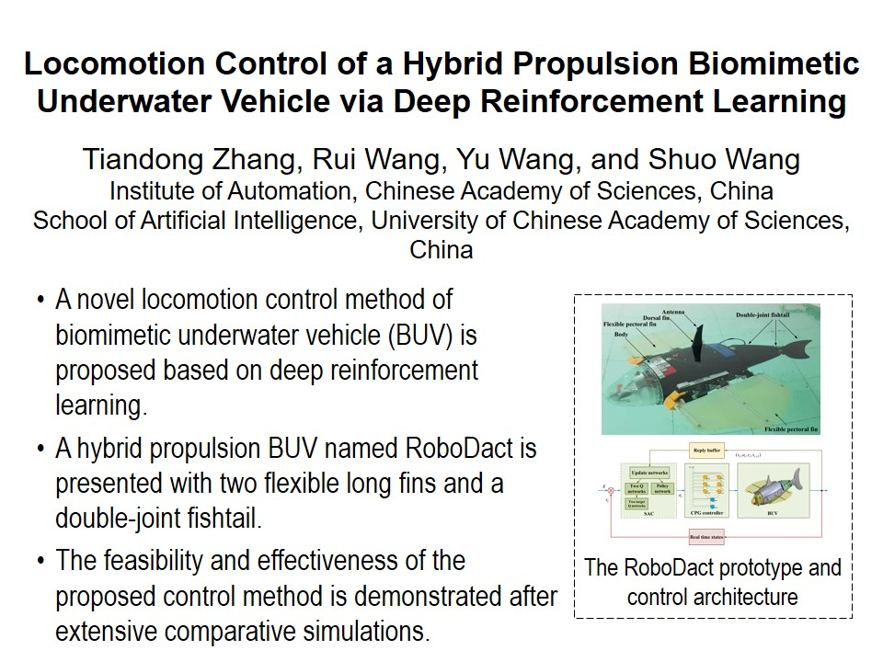
RCAR2021 Technical Sessions
ThC Ⅱ : Robotic Control II
Session Chair : Bo Yang, Rui Wang
Meeting Room 1 : July 15, 16:15 - 18:00, Thursday
16:15~16:30
16:30~16:45
16:45~17:00
17:00~17:15
17:15~17:30
17:30~17:45
T-7

Slide 8
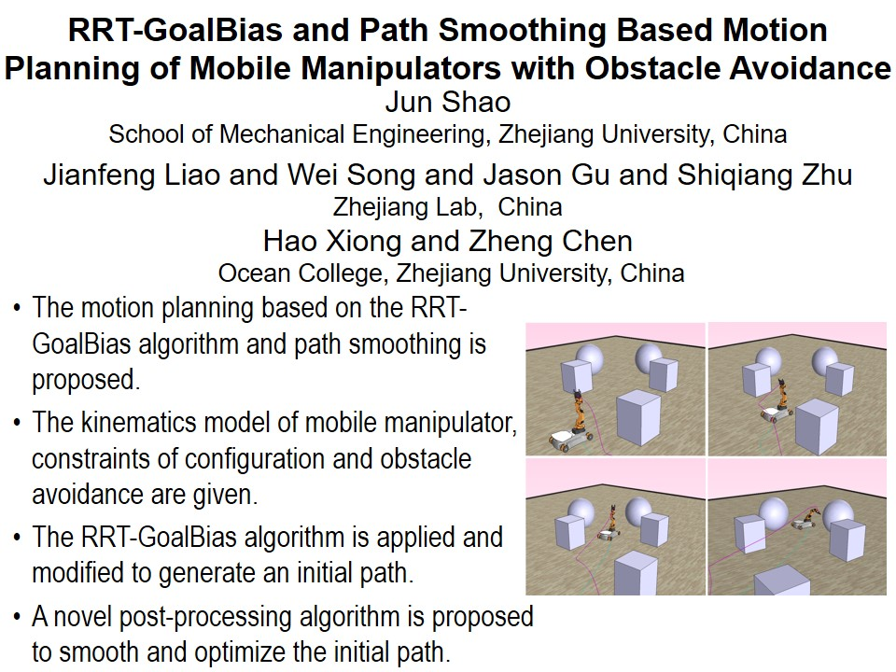
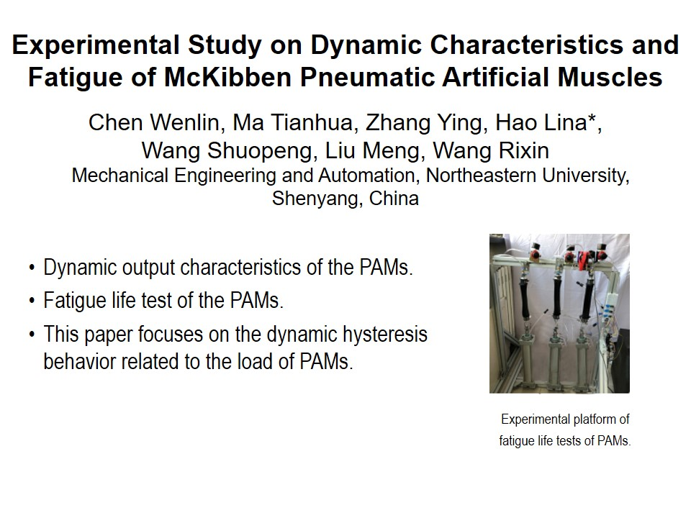
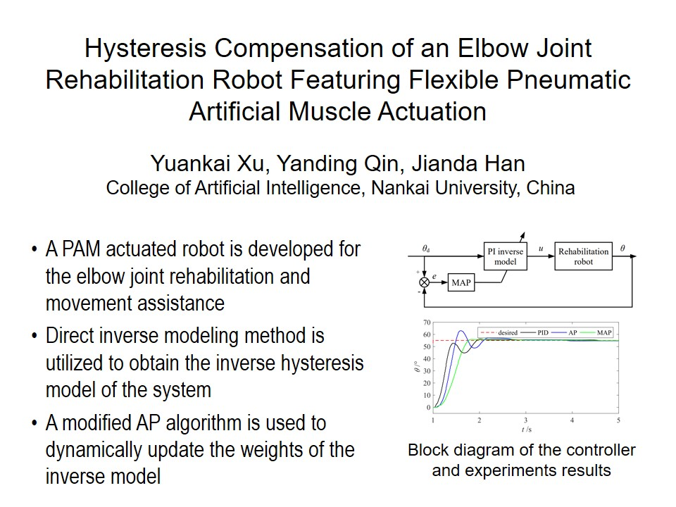
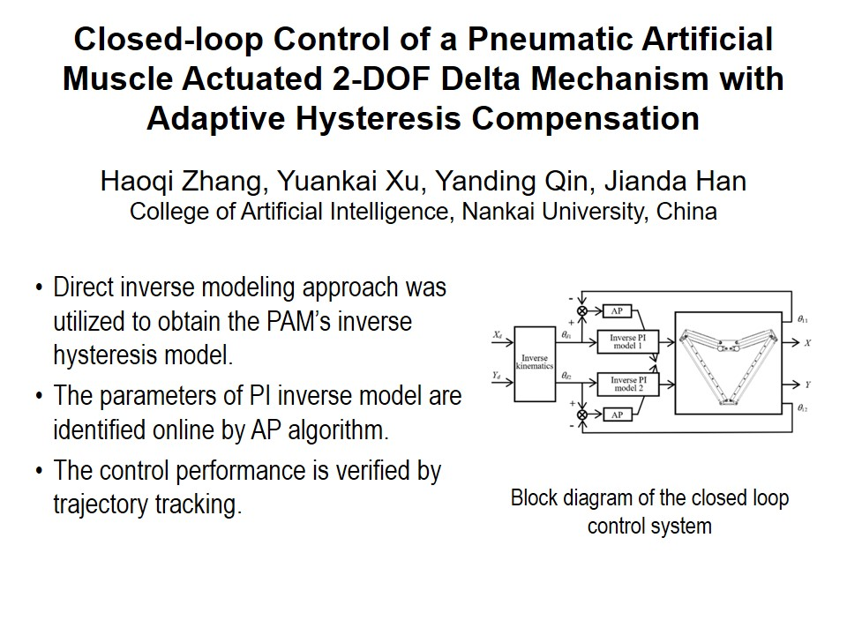
RCAR2021 Technical Sessions
ThD Ⅱ : Soft robotic system II
Session Chair : Yanding Qin, Lina Hao
Meeting Room 2 : July 15, 16:15 - 18:00, Thursday
16:15~16:30
16:30~16:45
16:45~17:00
17:00~17:15
T-8

Slide 9
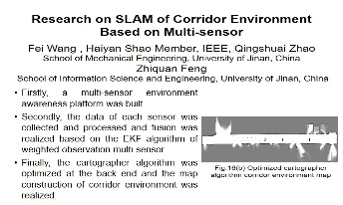
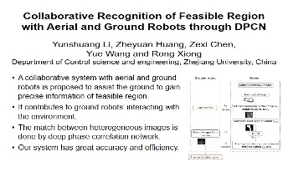
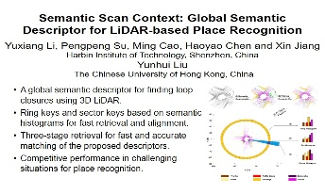
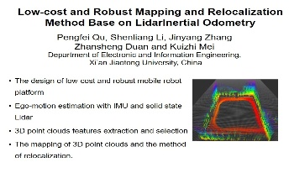
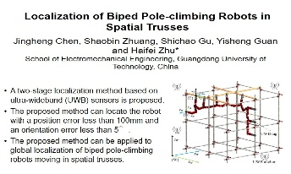
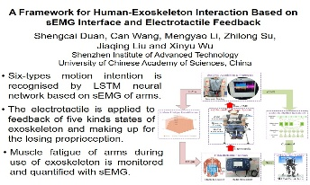
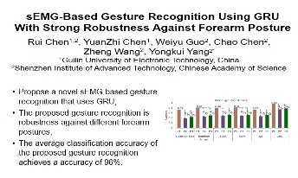
RCAR2021 Technical Sessions
FrA I : Sensing technology and recognition
Session Chair : Xin Jiang, Shengcai Duan
Jingya Pavilion : July 16, 14:00 - 15:45, Friday
14:00~14:15
14:15~14:30
14:30~14:45
14:45~15:00
15:00~15:15
15:15~15:30
15:30~15:45
T-9

Slide 10
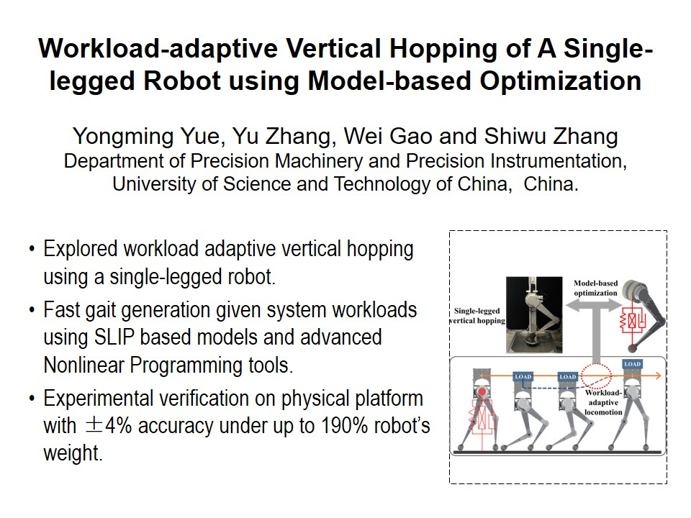
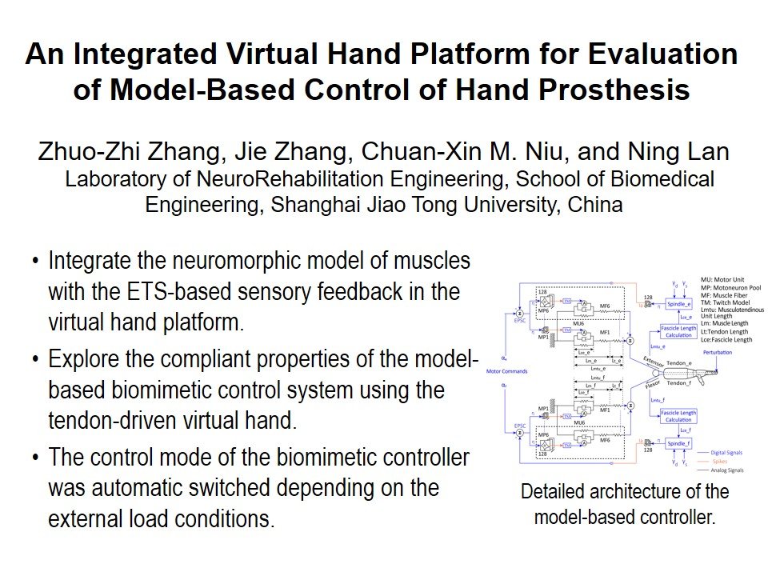
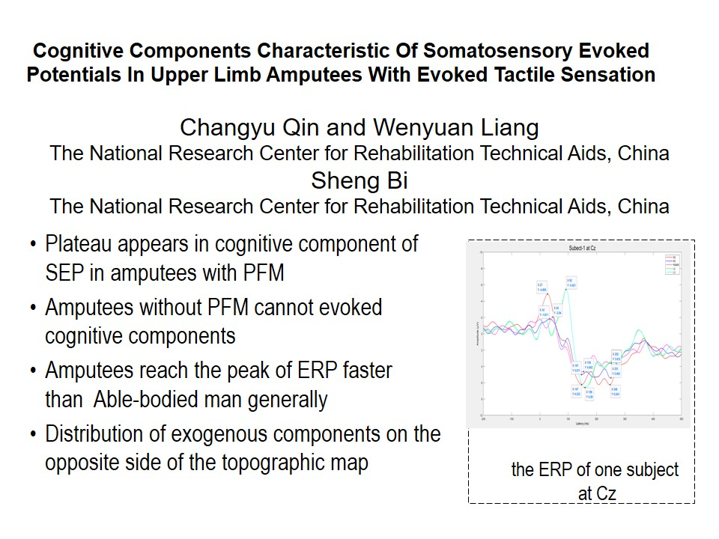
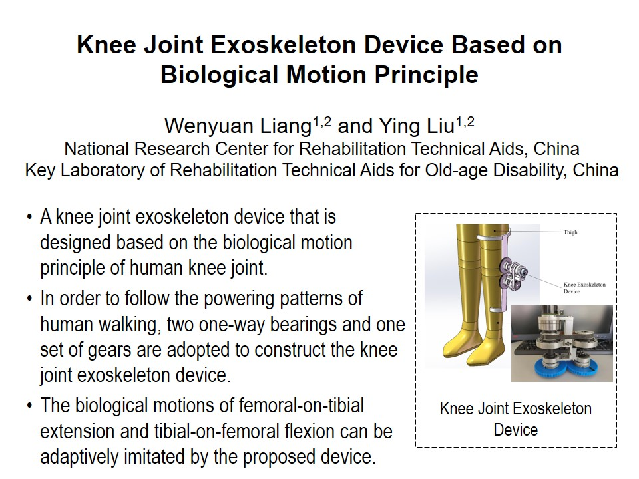


RCAR2021 Technical Sessions
FrB I : Human-Machine Interface I
Session Chair : Guanglin Li, Ning Lan
Lanting Pavilion : July 16, 14:00 - 15:45, Friday
14:00~14:15
14:15~14:30
14:30~14:45
14:45~15:00
15:00~15:15
15:15~15:30
T-10

Slide 11






RCAR2021 Technical Sessions
FrC I : Robot Mechanism I
Session Chair : Changsheng Li, Linsen Xu
Meeting Room 1 : July 16, 14:00 - 15:45, Friday
14:00~14:15
14:15~14:30
14:30~14:45
14:45~15:00
15:00~15:15
15:15~15:30
T-11

Slide 12







RCAR2021 Technical Sessions
FrD I : Vision I
Session Chair : Dapeng Tian, Zhi Han
Meeting Room 2 : July 16, 14:00 - 15:45, Friday
14:00~14:15
14:15~14:30
14:30~14:45
14:45~15:00
15:00~15:15
15:15~15:30
15:30~15:45
T-12

Slide 13







RCAR2021 Technical Sessions
FrA Ⅱ : Mobile Robots I
Session Chair : Hongpeng Wang, Ziwei Zhou
Jingya Pavilion : July 16, 16:15 - 18:00, Friday
16:15~16:30
16:30~16:45
16:45~17:00
17:00~17:15
17:15~17:30
17:30~17:45
17:45~18:00
T-13

Slide 14





RCAR2021 Technical Sessions
FrB Ⅱ : Human-Machine Interface II
Session Chair : Guanglin Li, Ning Lan
Lanting Pavilion : July 16, 16:15 - 18:00, Friday
16:15~16:30
16:30~16:45
16:45~17:00
17:00~17:15
17:15~17:30
T-14

Slide 15







RCAR2021 Technical Sessions
FrC Ⅱ : Robotic control III
Session Chair : Xin Wang, Xin Shi
Meeting Room 1 : July 16, 16:15 - 18:00, Friday
16:15~16:30
16:30~16:45
16:45~17:00
17:00~17:15
17:15~17:30
17:30~17:45
T-15

Slide 16






RCAR2021 Technical Sessions
FrD Ⅱ : Learning I
Session Chair : Yong He, Shifeng Guo
Meeting Room 2 : July 16, 16:15 - 18:00, Friday
16:15~16:30
16:30~16:45
16:45~17:00
17:00~17:15
17:15~17:30
17:30~17:45
T-16

Slide 17






RCAR2021 Technical Sessions
SaA I : Vision II
Session Chair : Yunjiang Lou, Yue Ma
Jingya Pavilion : July 17, 8:30 - 10:15, Saturday
8:30~8:45
8:45~9:00
9:00~9:15
9:15~9:30
9:30~9:45
9:45~10:00
T-17

Slide 18






RCAR2021 Technical Sessions
SaB I : Advanced Control I
Session Chair : Jingshuai Liu, Qiang Qu
Lanting Pavilion : July 17, 8:30 - 10:15, Saturday
8:30~8:45
8:45~9:00
9:00~9:15
9:15~9:30
9:30~9:45
9:45~10:00
T-18

Slide 19







RCAR2021 Technical Sessions
SaC I : Learning II
Session Chair : Hui Cao, Chunjie Chen
Meeting Room 1 : July 17, 8:30 - 10:15, Saturday
8:30~8:45
8:45~9:00
9:00~9:15
9:15~9:30
9:30~9:45
9:45~10:00
10:00~10:15
T-19

Slide 20







RCAR2021 Technical Sessions
SaD I : Robot Mechanism II
Session Chair : Jianquan Sun, Jizhuang Fan
Meeting Room 2 : July 17, 8:30 - 10:15, Saturday
8:30~8:45
8:45~9:00
9:00~9:15
9:15~9:30
9:30~9:45
9:45~10:00
10:00~10:15
T-20

Slide 21






RCAR2021 Technical Sessions
SaA Ⅱ : Vision III
Session Chair : Chao Wang, Feifei Gu
Jingya Pavilion : July 17, 10:45 - 12:30, Saturday
10:45~11:00
11:00~11:15
11:15~11:30
11:30~11:45
11:45~12:00
12:00~12:15
T-21

Slide 22






RCAR2021 Technical Sessions
SaB Ⅱ : Advanced Control II
Session Chair : Wei Chen, Haoyao Chen
Lanting Pavilion : July 17, 10:45 - 12:30, Saturday
10:45~11:00
11:00~11:15
11:15~11:30
11:30~11:45
11:45~12:00
12:00~12:15
T-22

Slide 23







RCAR2021 Technical Sessions
SaC Ⅱ : Planning and Navigation
Session Chair : Hang Yu, Yizhai Zhang
Meeting Room 1 : July 17, 10:45 - 12:30, Saturday
10:45~11:00
11:00~11:15
11:15~11:30
11:30~11:45
11:45~12:00
12:00~12:15
12:15~12:30
T-23

Slide 24






RCAR2021 Technical Sessions
SaD Ⅱ : Robotic Control IV
Session Chair : Mingjie Dong, Pengyue Zhang
Meeting Room 2 : July 17, 10:45 - 12:30, Saturday
10:45~11:00
11:00~11:15
11:15~11:30
11:30~11:45
11:45~12:00
12:00~12:15
T-24

Slide 25







RCAR2021 Technical Sessions
SuA I : Vision IV
Session Chair : Lei Wang, Yue Wang
Tencent ID: 234 889 136 : July 18, 8:30 - 10:15, Sunday
8:30~8:45
8:45~9:00
9:00~9:15
9:15~9:30
9:30~9:45
9:45~10:00
10:00~10:15
T-25

Slide 26







RCAR2021 Technical Sessions
SuA II : Robotic Control V
Session Chair : Yajing Shen, Jinke Li
Tencent ID: 234 889 136 : July 18, 10:45 - 12:30, Sunday
10:45~11:00
11:00~11:15
11:15~11:30
11:30~11:45
11:45~12:00
12:00~12:15
12:15~12:30
T-26

Slide 27






RCAR2021 Technical Sessions
SuA III : Advanced Control III
Session Chair : Miaomiao Wang, Jianxin Pang
Tencent ID: 234 889 136 : July 18, 14:00 - 15:45, Sunday
14:00~14:15
14:15~14:30
14:30~14:45
14:45~15:00
15:00~15:15
15:15~15:30
T-27

Slide 28






RCAR2021 Technical Sessions
SuA IV : Vision V
Session Chair : Qieshi Zhang, Chengzhi Hu
Tencent ID : 234 889 136 : July 18, 16:15 - 18:00, Sunday
16:15~16:30
16:30~16:45
16:45~17:00
17:00~17:15
17:15~17:30
17:30~17:45
T-28

Slide 29








RCAR2021 Technical Sessions
SuB I : Modelling I
Session Chair : Weixin Si, Xiaodong Yang
Tencent ID: 311 159 883 : July 18, 8:30 - 10:15, Sunday
8:30~8:45
8:45~9:00
9:00~9:15
9:15~9:30
9:30~9:45
9:45~10:00
10:00~10:15
10:15~10:30
T-29

Slide 30







RCAR2021 Technical Sessions
SuB II : Mobile robots II
Session Chair : Xiaoqiang Ji, Wei Guo
Tencent ID: 311 159 883 : July 18, 10:45 - 12:30, Sunday
10:45~11:00
11:00~11:15
11:15~11:30
11:30~11:45
11:45~12:00
12:00~12:15
12:15~12:30
T-30

Slide 31






RCAR2021 Technical Sessions
SuB III : Wearable robots
Session Chair : Lin Wang, Qingsong Li
Tencent ID: 311 159 883 : July 18, 14:00 - 15:45, Sunday
14:00~14:15
14:15~14:30
14:30~14:45
14:45~15:00
15:00~15:15
15:15~15:30
T-31

Slide 32








RCAR2021 Technical Sessions
SuB IV : Learning III
Session Chair : Cai Chen, Zhengkun Yi
Tencent ID : 311 159 883 : July 18, 16:15 - 18:00, Sunday
16:15~16:30
16:30~16:45
16:45~17:00
17:00~17:15
17:15~17:30
17:30~17:45
17:45~18:00
18:00~18:15
T-32

Slide 33







RCAR2021 Technical Sessions
MoA I : Vision VI
Session Chair : Yuming Dong, Wanfeng Shang
Tencent ID: 200 149 087 : July 19, 8:30 - 10:15, Monday
8:30~8:45
8:45~9:00
9:00~9:15
9:15~9:30
9:30~9:45
9:45~10:00
10:00~10:15
T-33

Slide 34







RCAR2021 Technical Sessions
MoA II : Robotic Control VI
Session Chair : Ning Ding, Hongliu Yu
Tencent ID: 200 149 087 : July 19, 10:45 - 12:30, Monday
10:45~11:00
11:00~11:15
11:15~11:30
11:30~11:45
11:45~12:00
12:00~12:15
12:15~12:30
T-34

Slide 35








RCAR2021 Technical Sessions
MoA III : Vision VII
Session Chair : Sheng Xu, Zhan Yang
Tencent ID: 200 149 087 : July 19, 14:00 - 15:45, Monday
14:00~14:15
14:15~14:30
14:30~14:45
14:45~15:00
15:00~15:15
15:15~15:30
15:30~15:45
15:45~16:00
T-35

Slide 36







RCAR2021 Technical Sessions
MoA IV : Robotic Control VII
Session Chair : Haojian Lu, Peng Li
Tencent ID: 200 149 087 : July 19, 16:15 - 18:00, Monday
16:15~16:30
16:30~16:45
16:45~17:00
17:00~17:15
17:15~17:30
17:30~17:45
17:45~18:00
T-36

Slide 37







RCAR2021 Technical Sessions
MoB I : Advanced Control IV
Session Chair : Ye Wang, Fan Zhang
Tencent ID: 944 405 004 : July 19, 8:30 - 10:15, Monday
8:30~8:45
8:45~9:00
9:00~9:15
9:15~9:30
9:30~9:45
9:45~10:00
10:00~10:15
T-37

Slide 38








RCAR2021 Technical Sessions
MoB II : Robot Mechanism III
Session Chair : Qiao Hu, Yanlong Tai
Tencent ID: 944 405 004 : July 19, 10:45 - 12:30, Monday
10:45~11:00
11:00~11:15
11:15~11:30
11:30~11:45
11:45~12:00
12:00~12:15
12:15~12:30
12:30~12:45
T-38

Slide 39







RCAR2021 Technical Sessions
MoB III : Robotic Control VIII
Session Chair : Huihuan Qian, Huiyun Li
Tencent ID: 944 405 004 : July 19, 14:00 - 15:45, Monday
14:00~14:15
14:15~14:30
14:30~14:45
14:45~15:00
15:00~15:15
15:15~15:30
15:30~15:45
T-39

